Slide 1
Python Programming - III
-By Nimesh Kumar Dagur, CDAC, India

Slide 2

Python Tuples
A tuple is another sequence data type that is similar to the list.
A tuple consists of a number of values separated by commas.
Unlike lists, however, tuples are enclosed within parentheses.
The main differences between lists and tuples are: Lists are enclosed in brackets ( [ ] ) and their elements and size can be changed, while tuples are enclosed in parentheses ( ( ) ) and cannot be updated.
Tuples can be thought of as read-only lists.
The parentheses are optional but is a good practice to write it.
A tuple can have any number of items and they may be of different types (integer, float, list, string etc.).

Slide 3
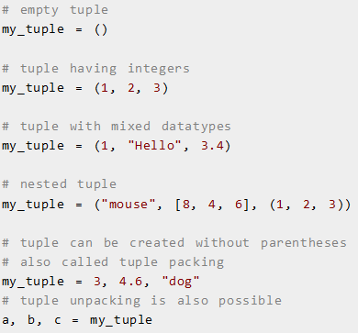
Python Tuples

Slide 4
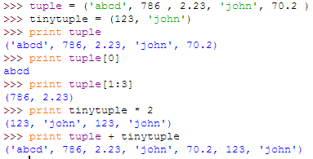
Python Tuples

Slide 5
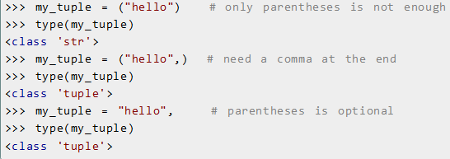
Python Tuples
Creating a tuple with one element is a bit tricky.
Having one element within parentheses is not enough.
We will need a trailing comma to indicate that it is in fact a tuple.

Slide 6
Accessing Elements in a Tuple
There are various ways in which we can access the elements of a tuple.
Indexing: We can use the index operator [] to access an item in a tuple.
Index starts from 0. So, a tuple having 6 elements will have index from 0 to 5.
Trying to access an element other that this will raise an IndexError.
The index must be an integer. We can't use float or other types, this will result into TypeError.
Nested tuple are accessed using nested indexing.

Slide 7
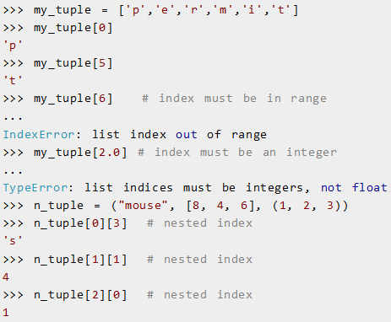
Accessing Elements in a Tuple

Slide 8
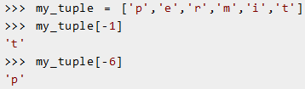
Negative Indexing: Python allows negative indexing for its sequences.
The index of -1 refers to the last item, -2 to the second last item and so on

Slide 9
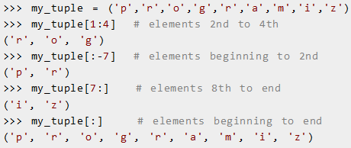
Slicing: We can access a range of items in a tuple by using the slicing operator (colon).

Slide 10
Changing or Deleting a Tuple
Unlike lists, tuples are immutable.
This means that elements of a tuple cannot be changed once it has been assigned.
But if the element is itself a mutable datatype like list, its nested items can be changed.
We can also assign a tuple to different values (reassignment).

Slide 11
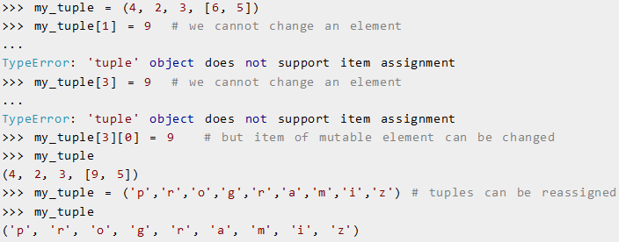
Changing or Deleting a Tuple

Slide 12

We can use + operator to combine two tuples. This is also called concatenation.
The * operator repeats a tuple for the given number of times. These operations result into a new tuple.

Slide 13
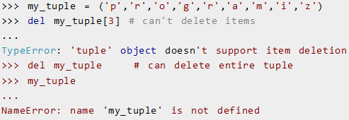
We cannot delete or remove items from a tuple.
But deleting the tuple entirely is possible using the keyword del.

Slide 14
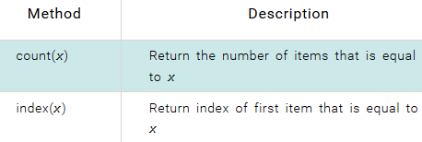
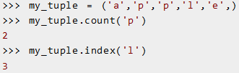
Python Tuple Methods
Methods that add items or remove items are not available with tuple.

Slide 15
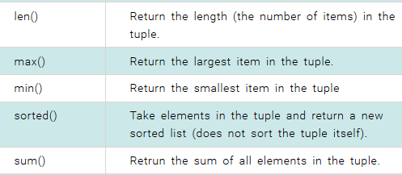
Built-in Functions with Tuple

Slide 16
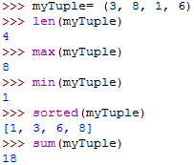
Built-in Functions with Tuple

Slide 17
Advantage of Tuple over List
Tuples and list look quite similar except the fact that one is immutable and the other is mutable.
We generally use tuple for heterogeneous (different) datatypes and list for homogeneous (similar) datatypes.
There are some advantages of implementing a tuple than a list. Here are a few of them:
Since tuple are immutable, iterating through tuple is faster than with list. So there is a slight performance boost.
Tuples that contain immutable elements can be used as key for a dictionary. With list, this is not possible.
If you have data that doesn't change, implementing it as tuple will guarantee that it remains write-protected.

Slide 18
Decision making in Python
Decision making structures require that the programmer specify one or more conditions to be evaluated or tested by the program, along with a statement or statements to be executed if the condition is determined to be true, and optionally, other statements to be executed if the condition is determined to be false.

Slide 19
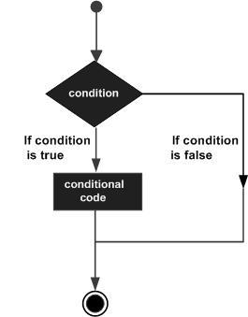
General form of a typical decision making structure
Python programming language assumes any non-zero and non-null values as true, and if it is either zero or null, then it is assumed as false value.

Slide 20
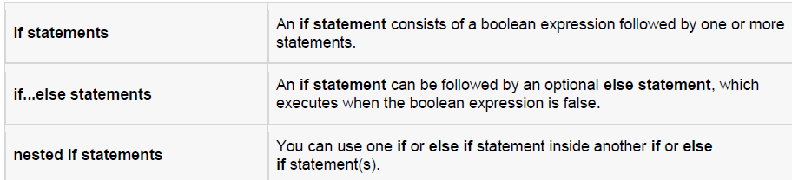
Types of decision making statements

Slide 21
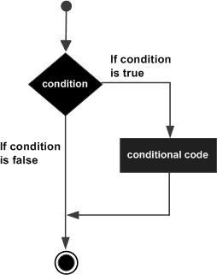

If statements
The if statement contains a logical expression using which data is compared and a decision is made based on the result of the comparison.
Syntax:

Slide 22
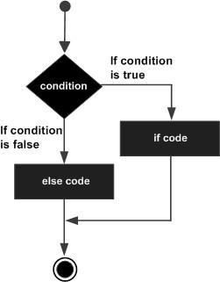
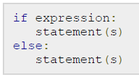
If-else statements
An else statement can be combined with an if statement. An else statement contains the block of code that executes if the conditional expression in the if statement resolves to 0 or a false value.
Syntax:

Slide 23
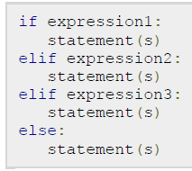
The elif Statement
The elif statement allows you to check multiple expressions for truth value and execute a block of code as soon as one of the conditions evaluates to true.
Syntax:

Slide 24
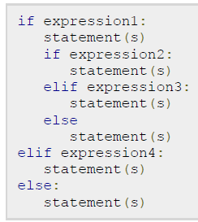
Nested if statements
There may be a situation when you want to check for another condition after a condition resolves to true. In such a situation, you can use the nested if construct.
Syntax:

Slide 25
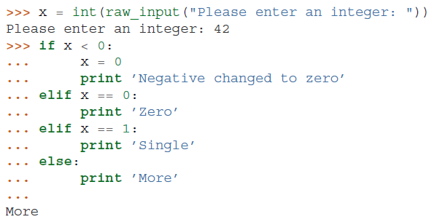
Example

Slide 26
Loops in Python
There may be a situation when you need to execute a block of code several number of times.
In general, statements are executed sequentially: The first statement in a function is executed first, followed by the second, and so on.
Programming languages provide various control structures that allow for more complicated execution paths.
A loop statement allows us to execute a statement or group of statements multiple times

Slide 27
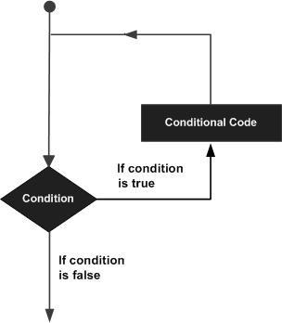
General form of a loop statement

Slide 28
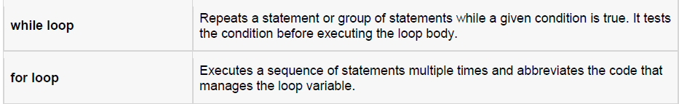
Types of loops

Slide 29
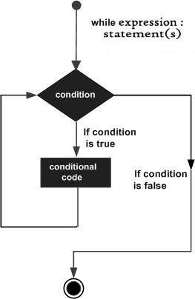

while loop
A while loop statement in Python programming language repeatedly executes a target statement as long as a given condition is true
Syntax:
Here, statement(s) may be a single statement or a block of statements. The condition may be any expression, and true is any non-zero value. The loop iterates while the condition is true. When the condition becomes false, program control passes to the line immediately following the loop.

Slide 30

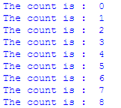
Example

Slide 31
The else Statement Used with Loops
Python supports to have an else statement associated with a loop statement.
If the else statement is used with a for loop, the else statement is executed when the loop has exhausted iterating the list.
If the else statement is used with a while loop, the else statement is executed when the condition becomes false.

Slide 32
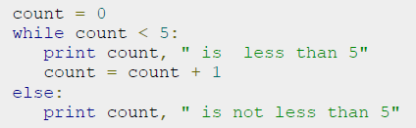

Example

Slide 33

for loop
The for loop in Python has the ability to iterate over the items of any sequence, such as a list or a string.
Syntax:
If a sequence contains an expression list, it is evaluated first. Then, the first item in the sequence is assigned to the iterating variable iterating_var. Next, the statements block is executed.
Each item in the list is assigned to iterating_var, and the statement(s) block is executed until the entire sequence is exhausted.

Slide 34
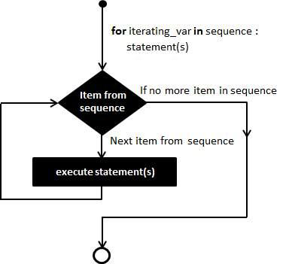

Slide 35

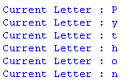
Example

Slide 36
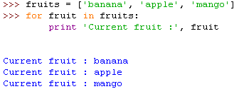

Slide 37

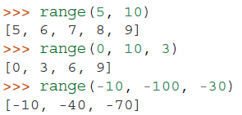
The range() Function
The built-in function range() is used to iterate over a sequence of numbers
It is possible to let the range start at another number, or to specify a different increment (even negative; sometimes this is called the ‘step’):

Slide 38
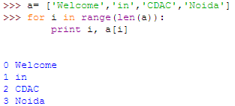

Slide 39
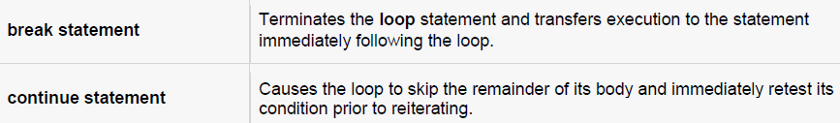
Loop Control Statements
Loop control statements change execution from its normal sequence.

Slide 40

break statement
The break statement in Python terminates the current loop and resumes execution at the next statement, just like the traditional break found in C.
The break statement can be used in both while and for loops.
If you are using nested loops (i.e., one loop inside another loop), the break statement will stop the execution of the innermost loop and start executing the next line of code after the block.
Syntax:

Slide 41
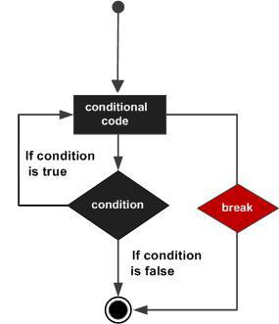
Flow Diagram of break

Slide 42
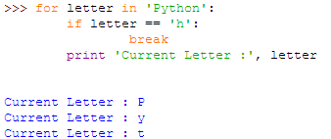
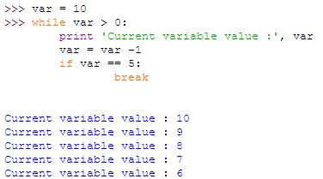
Example
continue

Slide 43

continue statement
The continue statement in Python returns the control to the beginning of the while loop.
The continue statement rejects all the remaining statements in the current iteration of the loop and moves the control back to the top of the loop.
The continue statement can be used in both while and for loops.
Syntax:

Slide 44
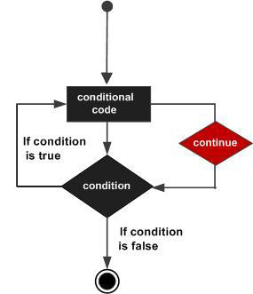

Slide 45
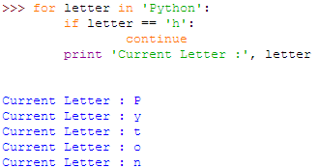
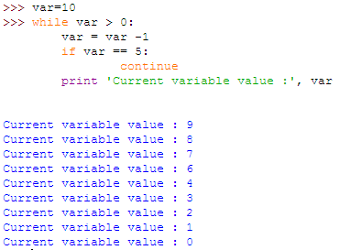
Example(s)

Slide 46
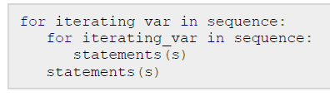
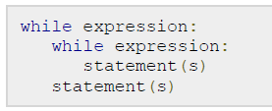
nested loops
Python programming language allows to use one loop inside another loop.
Syntax:

Slide 47
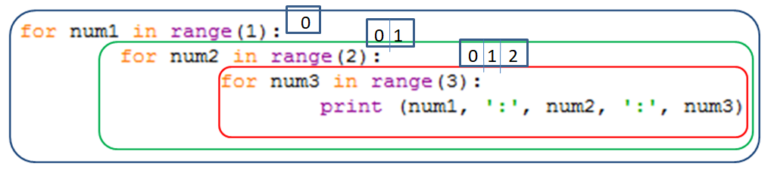

Nested loop
0
1
2

Slide 48
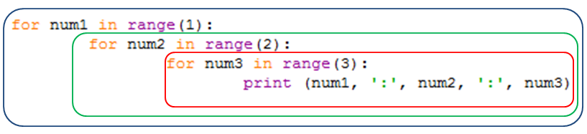
Nested loop

Slide 49


Slide 50
Python Dictionary
Python dictionary is an unordered(upto 3.7) collection of items.
While other compound datatypes have only value as an element, a dictionary has a key: value pair.
Dictionaries are optimized to retrieve values when the key is known.
Creating a dictionary is as simple as placing items inside curly braces {} separated by comma.
An item has a key and the corresponding value expressed as a pair, key: value.
While values can be of any datatype and can repeat, keys must be of immutable type (string, number or tuple with immutable elements) and must be unique.
We can also create a dictionary using the built-in function dict().

Slide 51
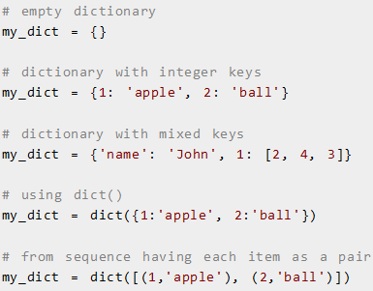
Python Dictionary

Slide 52
Accessing Elements in a Dictionary
While indexing is used with other container types to access values, dictionary uses keys.
Key can be used either inside square brackets or with the get() method.
The difference while using get() is that it returns None instead of KeyError, if the key is not found.

Slide 53
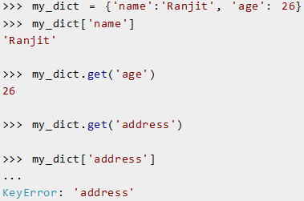

Slide 54
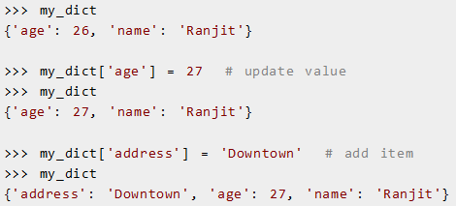
Changing or Adding Elements in a Dictionary
Dictionary are mutable.
We can add new items or change the value of existing items using assignment operator.
If the key is already present, value gets updated, else a new key: value pair is added to the dictionary.

Slide 55
Deleting or Removing Elements from a Dictionary
We can remove a particular item in a dictionary by using the method pop().
This method removes as item with the provided key and returns the value.
The method, popitem() can be used to remove and return an arbitrary item (key, value) form the dictionary.
In python 3.0, popitem() will be used to remove last key:value pair.
All the items can be removed at once using the clear() method.
We can also use the del keyword to remove individual items or the entire dictionary itself.

Slide 56
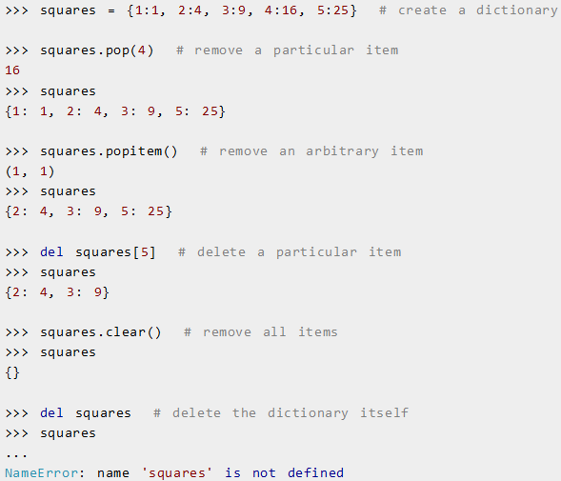

Slide 57
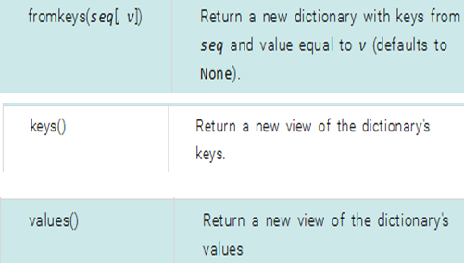
Python Dictionary Methods

Slide 58

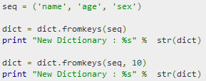

Python Dictionary Methods

Slide 59


Python Dictionary Methods

Slide 60
Python Sets
Set is an unordered collection of items.
Every element is unique (no duplicates) and must be immutable.
However, the set itself is mutable (we can add or remove items).
Sets can be used to perform mathematical set operations like union, intersection, symmetric difference etc.

Slide 61
Creating a Set in Python
A set is created by placing all the items (elements) inside curly braces {}, separated by comma or by using the built-in function set().
It can have any number of items and they may be of different types (integer, float, tuple, string etc.).
But a set cannot have a mutable element, like list, set or dictionary, as its element.

Slide 62
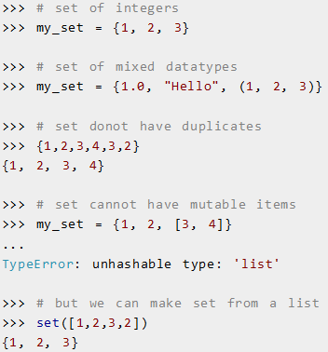
Creating a Set in Python

Slide 63
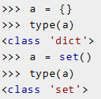
Creating a Set in Python
Creating an empty set is a bit tricky.
Empty curly braces {} will make an empty dictionary in Python.
To make a set without any elements we use the set() function without any argument.

Slide 64
Changing a Set in Python
Sets are mutable.
But since they are unordered, indexing have no meaning.
We cannot access or change an element of set using indexing or slicing. Set does not support it.
We can add single elements using the method add().
Multiple elements can be added using update() method.
The update() method can take tuples, lists, strings or other sets as its argument.
In all cases, duplicates are avoided.

Slide 65
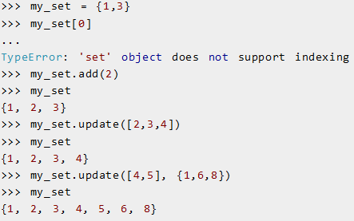
Changing a Set in Python

Slide 66

Removing Elements from a Set
A particular item can be removed from set using methods like discard() and remove().
The only difference between the two is that, while using discard() if the item does not exist in the set, it remains unchanged.
But remove() will raise an error in such condition.

Slide 67

Removing Elements from a Set
Similarly, we can remove and return an item using the pop() method.
Set being unordered, there is no way of determining which item will be popped.
It is completely arbitrary. We can also remove all items from a set using clear().

Slide 68

Python Set Operation
Sets can be used to carry out following mathematical set operations
union,
intersection,
difference and
symmetric difference.
We can do this with operators or methods.

Slide 69


Set Union
Union of A and B is a set of all elements from both sets.
Union is performed using | operator.
Same can be accomplished using the method union().
Example:

Slide 70


Set Intersection
Intersection of A and B is a set of elements that are common in both sets.
Intersection is performed using & operator.
Same can be accomplished using the method intersection().
Example:

Slide 71


Set Difference
Difference of A and B (A - B) is a set of elements that are only in A but not in B.
Similarly, B - A is a set of element in B but not in A.
Difference is performed using - operator.
Same can be accomplished using the method difference() .
Example:

Slide 72


Set Symmetric Difference
Symmetric Difference of A and B is a set of element in both A and B except those common in both.
Symmetric difference is performed using ^ operator.
Same can be accomplished using the method symmetric_difference().
Example:

Slide 73
Python Frozenset
Frozenset is a new class that has the characteristics of a set, but its elements cannot be changed once assigned.
While tuples are immutable lists, frozensets are immutable sets.
Sets being mutable are unhashable, so they can't be used as dictionary keys.
On the other hand, frozensets are hashable and can be used as keys to a dictionary.
Being immutable it does not have method that add or remove elements.

Slide 74

Python Frozenset

